Slide 1


Hii, Iam Siddhika
Welcome to Power BI Series
Part -21

Slide 2

Today Content
I’m soo Excited.
Are you ready guys?
Meet DAX
FILTER CONTEXT STEP-BY-STEP
MEASURE CALCULATION

Slide 3
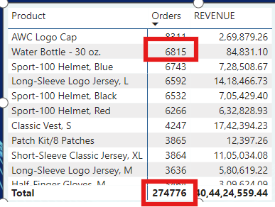

FILTER CONTEXT
Measures are evaluated based on filter context, which means that they recalculate
whenever the fields or filters around them change
Have you got it?
For this value in the matrix (6815), the Orders measure is calculated based on the following filter context: Products[Product Name] = “Water Bottle-30 oz”
This allows the measure to return the total order quantity for each product
specifically (or whatever
context the row and column labels dictate – years, countries, categories, customer names, etc.)
This total (274776) does NOT calculate by summing the values above; it evaluates as
an independent measure with no filter context applied

Slide 4
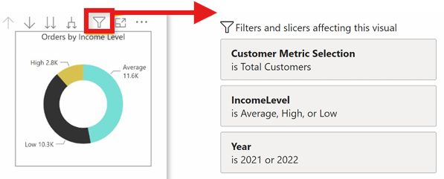


IMPORTANT: Every measure value in a report evaluates independently (like an island) and calculates based on its own filter context
Check this
TIP: Clicking the filter icon will show you the filters currently applied to a selected visual

Slide 5
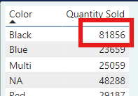


STEP-BY-STEP MEASURE CALCULATION
got it?
How exactly is this measure value calculated?
NOTE: This all happens instantly behind the scenes, every time the filter context changes

Slide 6
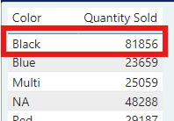

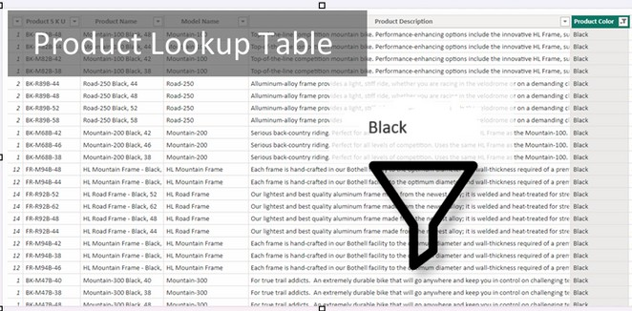
STEP 1
Filter context is detected & applied
Have you got it?
’Product Lookup’[Product Color] = “Black”

Slide 7
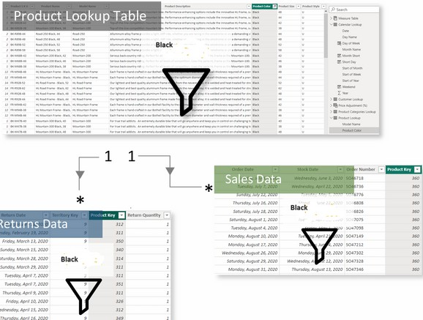
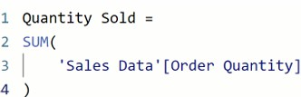
STEP 2
STEP 3
Filters flow “downstream” to related tables
Measure evaluates against the filtered table
Check this
Sum of values in the Order Quantity
column of the Sales Data table, filtered to
rows where the product color is “Black”
= 274776
Hey I took this Visual from internet for better understanding

Slide 8


Thank you for joining me today to learn about Part -21 of Power BI!
Remember, Learning DAX is key to unlocking the full potential of Power BI for insightful reporting and visualization.
Stay tuned for more insights and tips on Power BI in our next Series.
Follow
Siddhika Shah

